Slide 1
Imperial Ambitions and sectional crises, 1842-1861

Slide 2
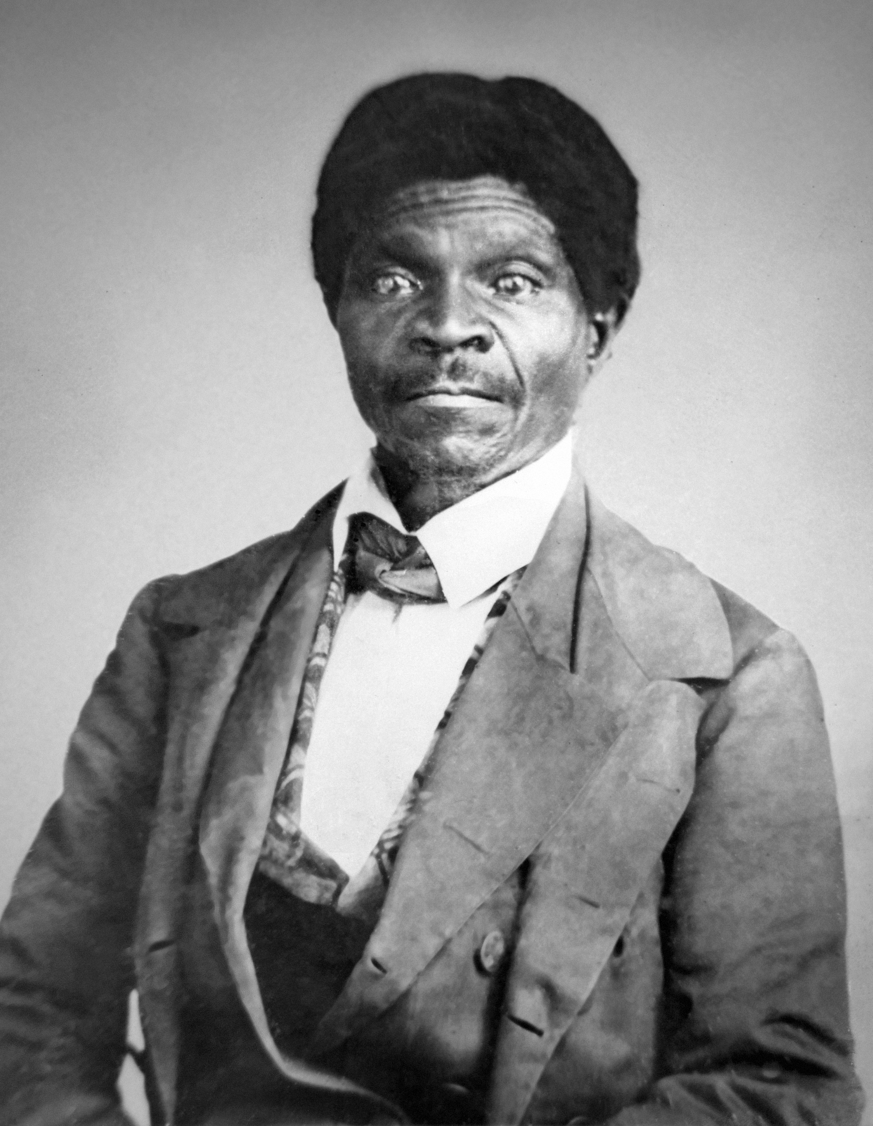
After listening to this lecture, you should be able to
Compare the experiences of different groups living in and migrating to the West
Explain how geographical expansion heightened sectional conflicts and how those conflicts shaped and were shaped by federal policies like the Compromise of 1850
Analyze the ways that the spread of anti-slavery sentiments, partisan politics, and federal court decisions intensified sectional divisions
Evaluate the importance of John Brown’s raid and the election of Abraham Lincoln to the presidency in convincing southern states to secede from the Union
Dred Scott

Slide 3
American Histories
John C. Fremont
&
Dred Scott

Slide 4
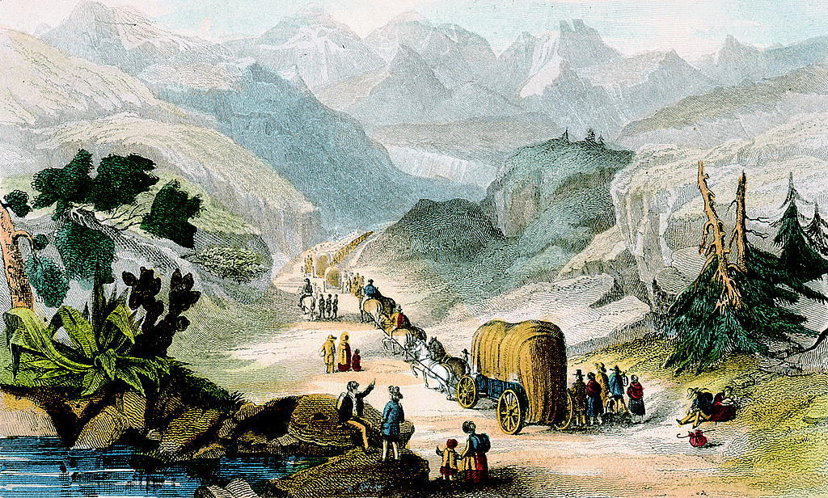
Claiming the West
Traveling the Overland Trail
The Gold Rush
A Crowded Land
Emigrant Party Headed to California in 1850:
This hand-colored engraving of a wagon train heading through a mountain pass shows the presence on many family groups and the need for many adults and children to walk and carry good for parts of the journey. It does NOT depict the many obstacles encountered in the journey.

Slide 5
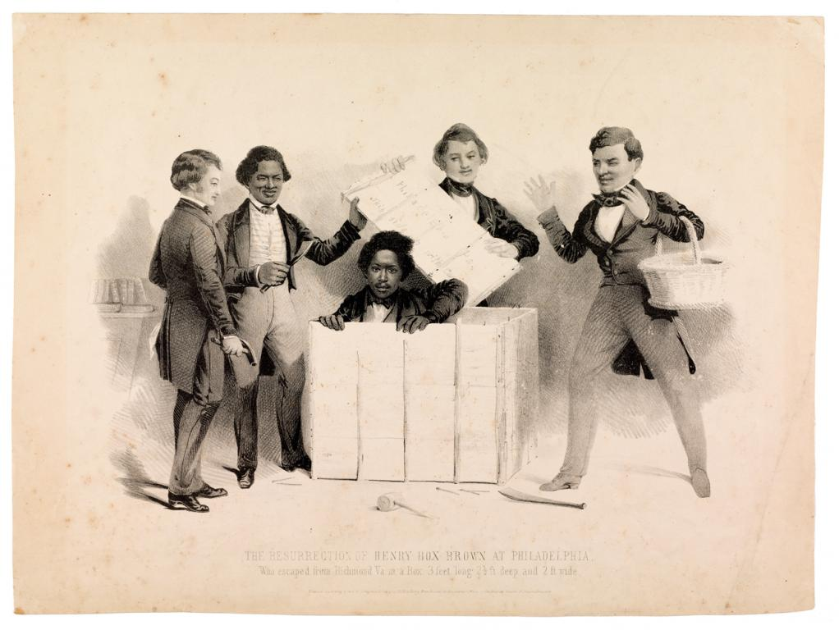
Expansion and the Politics of Slavery
California and the Compromise of 1850
The Fugitive Slave Act Inspires Northern Protest
Pierce Encourages US Expansion
The Resurrection of Henry Box Brown at Philadelphia:
Henry Brown escaped enslavement in Virginia in March 1849 by having himself shipped to Philadelphia in a crate. One of the most innovative means of gaining freedom, it required substantial assistance from supporters in Richmond and Philadelphia. The 1850 lithograph popularized Brown’s escape, furthering his career as a lecturer but making it hard for others to replicate his strategy.

Slide 6
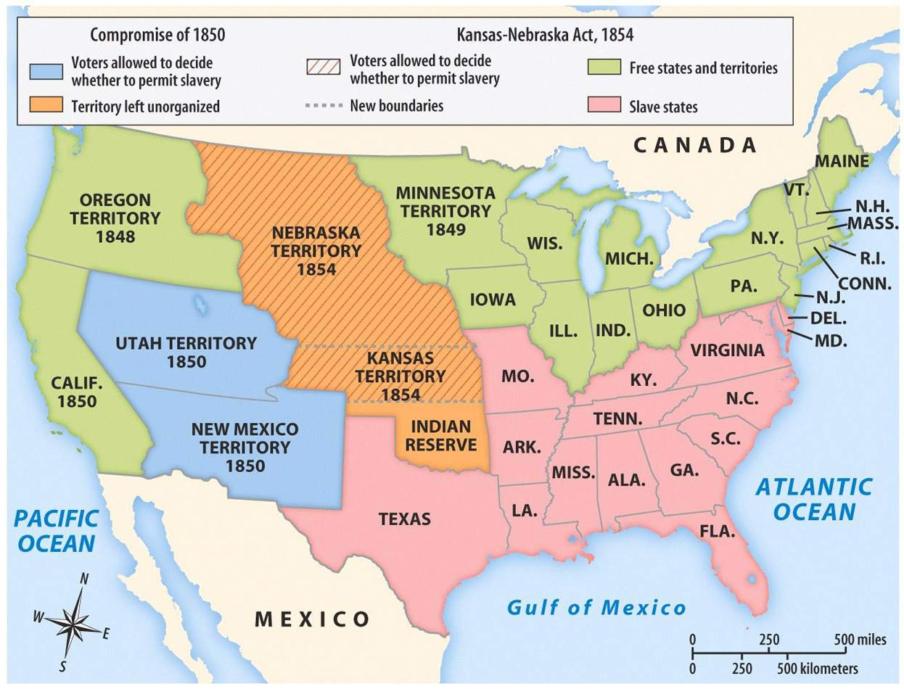
Sectional Crises Intensify
Popularizing Antislavery Sentiment
The Kansas-Nebraska Act Stirs Dissent-The Republican Party
Kansas-Nebraska Territory, 1854

Slide 7
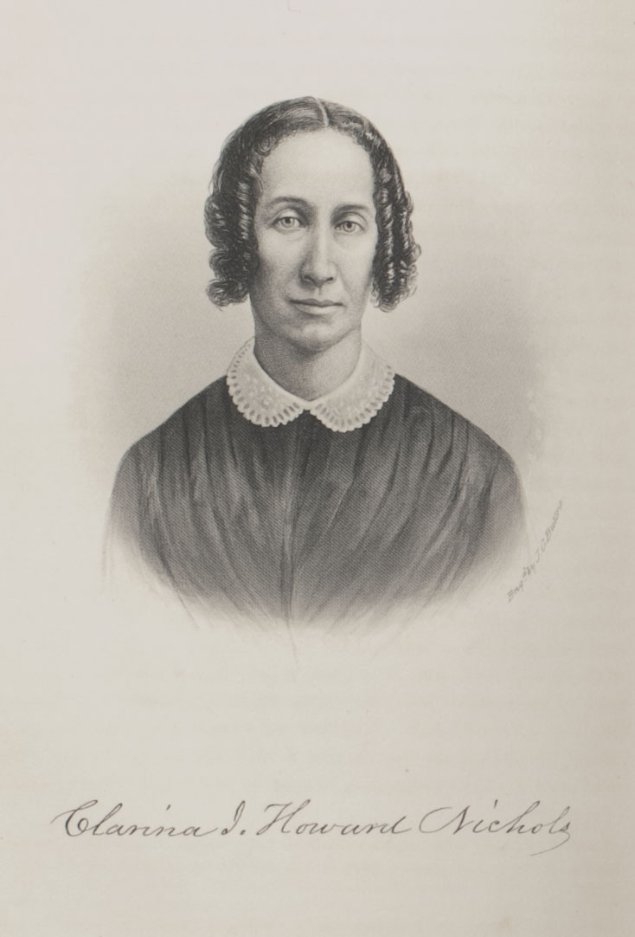
Bleeding Kansas and the Election of 1856
The Dred Scott Decision
Clarina Howard Nichols:
An abolitionist journalist and women’s rights advocate in Vermont, Clarina Howard Nichols joined the New England Emigrant Aid Society in 1854. The next year, she moved with her family to the Kansas Territory, where this photograph was taken. Nichols advocated women’s legal rights through lectures and editorials and was the only woman to participate in the Kansas Constitutional Convention of 1859.

Slide 8
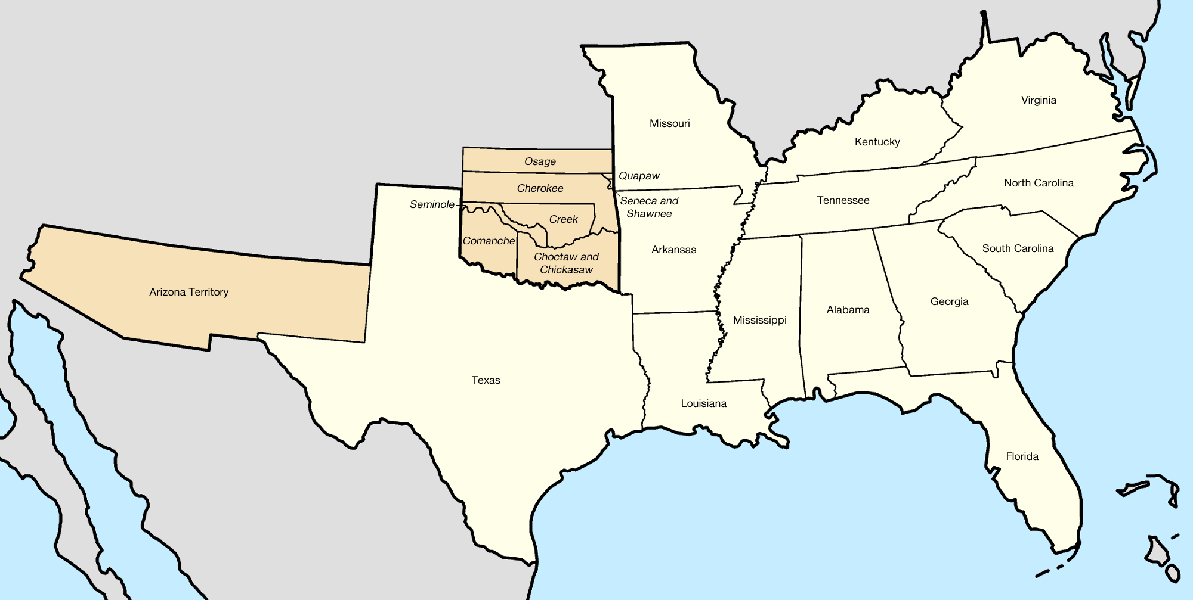
From Sectional Crisis to Southern Secession
John Brown’s Raid
The Election of 1860
The Lower South Secedes
The Confederacy:
Seven states in the Lower South seceded from the United States and formed the Confederate States of American in February 1861. While the original Confederacy was too limited in population and resources to defend itself against the US government, its leaders hoped that other slave states would soon join them.

Slide 9
Conclusion: A Nation divided
You should now be able to:
Compare the experiences of different groups living in and migrating to the West
Explain how geographical expansion heightened sectional conflicts and how those conflicts shaped and were shaped by federal policies like the Compromise of 1850
Analyze the ways that the spread of anti-slavery sentiments, partisan politics, and federal court decisions intensified sectional divisions
Evaluate the importance of John Brown’s raid and the election of Abraham Lincoln to the presidency in convincing southern states to secede from the Union

